Slide 1
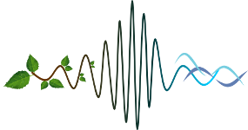
Using Animal Audio for Species Detection
Lin Schwarzkopf

Slide 2
Acknowledgements
Paul Roe Mike Towsey

Slide 3
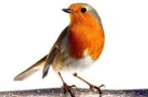
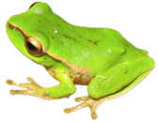
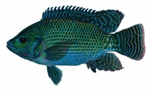
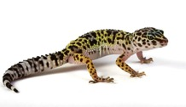
Why detect species?
We may want to
identify presence/absence, abundance or activity of individual species — study organism, rare, threatened
quantify numbers of species in an area in relation to habitat, anthropogenic disturbance — grazing, fire, urbanisation, etc.
Determine effects on ecosystem “health” — climate change, logging, agriculture, changes in land use etc.

Slide 4
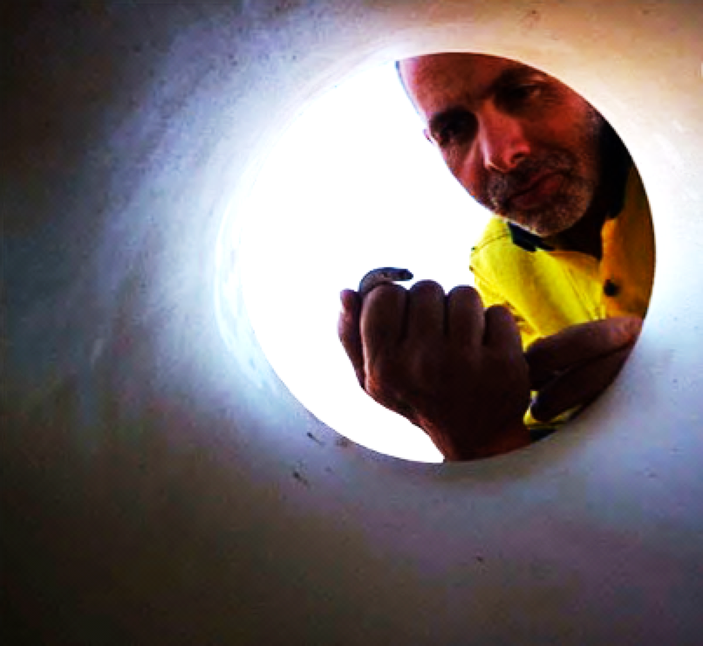
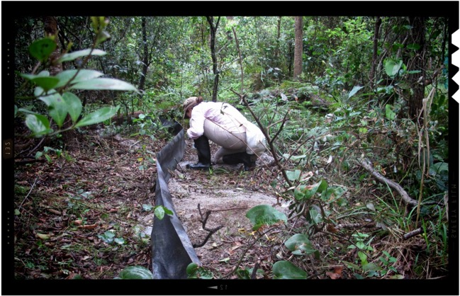
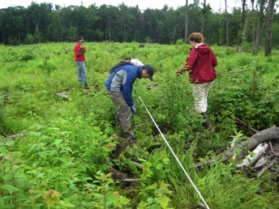
Traditional Monitoring
Fauna & vegetation surveys

Slide 5
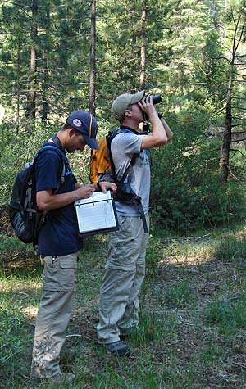
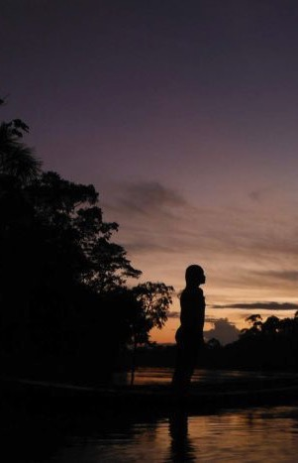
Traditional Audio Monitoring

Slide 6
Traditional Monitoring
Advantages:
— Provide highly accurate information on species presence/absence, activity & richness
Limitations:
— Highly spatially & very highly temporally restricted
— Expensive & time consuming to get a lot of data
— Limited to expertise that is present
— Observer bias

Slide 7
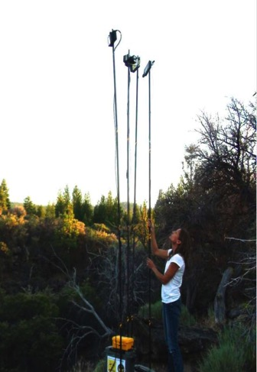
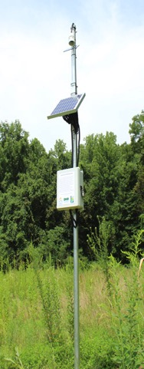
Autonomous Recording Units — Record Sound in situ
Advantages —
Non-invasive
Relatively cheap
Collect extensive audio data
Permanent record
Limited only by storage capacity – which continues to increase rapidly

Slide 8
Autonomous Recording Units — Record Sound in situ
Disadvantages —
Restricted to species that make some kind of noise
Birds, frogs, insects, some fish, some reptiles, many mammals
There is so much data analysing it becomes a problem!

Slide 9
Species Detection – Individual Species
Humans listen & recognise calls – subsampling in time
Songscope-type recognisers
Human-in-the-loop combinations

Slide 10
What’s better – ARUs or traditional methods?
Autonomous Recording Units (ARUs) versus point counts to quantify species richness and composition of birds in temperate interior forests.
Short-term monitoring, point counts may probably perform better than ARUs, especially to find rare or quiet species.
Long-term (seasonal or annual monitoring) ARUs a viable alternative to standard point-count methods
Klingbeil & Willig. 2015. PeerJ 3:e973; DOI 10.7717/peerj.973

Slide 11
What’s better – ARUs or traditional methods?
This study used ARUs almost exactly like point counts
Human observers at exactly the same time & place as recorders perform better – distant calls & difficult to hear calls, visual recognition
Used SongscopeTM to ID calls
Even using this method – ARUs larger samples over time produced better samples than human visits
Klingbeil & Willig. 2015. PeerJ 3:e973; DOI 10.7717/peerj.973

Slide 12
Species Detection – Individual Species
Humans listen & recognise calls – subsampling in time
Songscope-type recognisers
Human-in-the-loop combinations

Slide 13
Species Detection – Individual Species
Songscope-type automated “recognisers”
possible based on several different kinds of algorithms: fuzzy logic, dynamic time or Hidden Markov models, oscillation detection, event or syntactic pattern recognition
Speech recognition models are not very successful on environmental recordings because of their need for limited background noise
Animal calls vary more than human speech
Variable success dependent on type of background noise
Need to be trained for call & environment

Slide 14
Species Detection – Individual Species
Human-in-the-loop combinations
– best outcomes at the moment

Slide 15
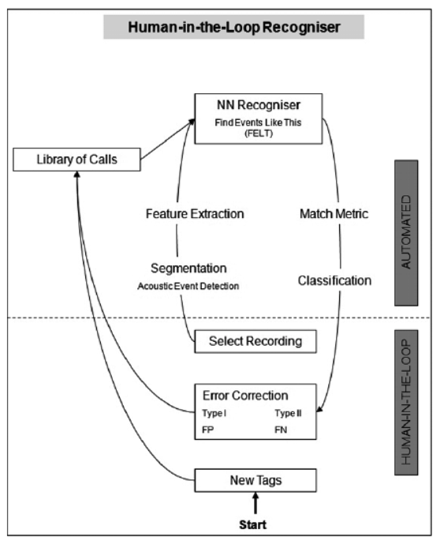

Slide 16
Indices of Ecosystem Health
Ecoacoustics, Soundscape Ecology
— Use Acoustic Indices
— Characterise animal acoustic communities, habitats, overall ecological state

Slide 17
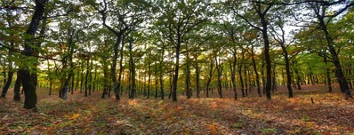
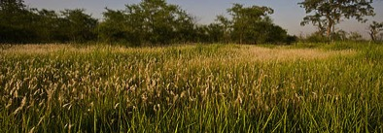
Acoustic Signatures
Natural soundscapes should be habitat specific.
Ambient sound in different types of forest was recorded
Used digital signal techniques and machine learning algorithms
Even fairly similar habitat types have specific acoustic signatures distinguishable by machine

Slide 18
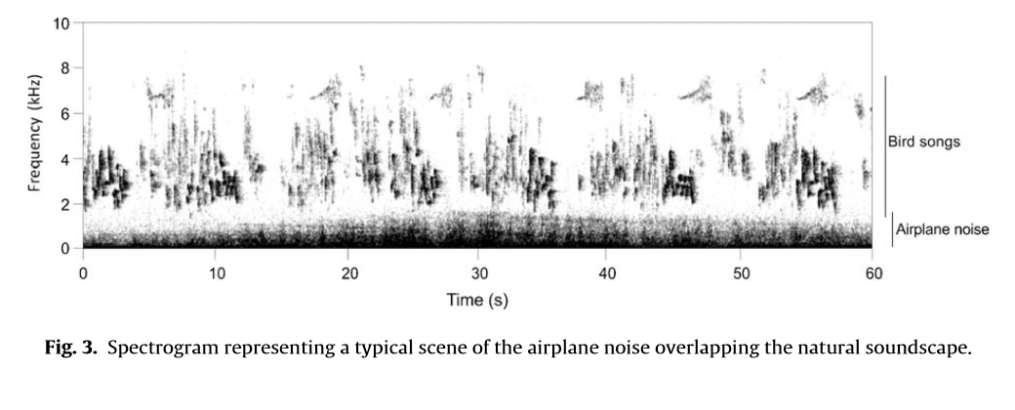
Acoustic Complexity Index
ACI highlights and quantifies complex biotic noise (ie. bird calls) while reducing effects of low-variability human noise (ie. airplane engines) Sueur et al. 2014. Acta Acustica 100:772-81.

Slide 19
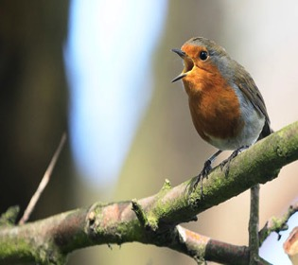
Can soundscape reflect landscape condition?
Soundscape patterns vary with landscape configuration and condition
19 forest sites in Eastern Australia
3 indices soundscape = landscape characteristics, ecological condition, and bird species richness
acoustic entropy (H), acoustic evenness (AEI), normalized difference soundscape index (NDSI)
Anthrophony was inversely correlated with biophony and ecological condition
Biophony positively correlated with ecological condition
Fuller et al. 2015. Ecological Indicators 58:207-15

Slide 20
Overall Signatures Not For Species Detection

Slide 21
Species Richness Applications
We want to know not only that a system is rich or diverse, or different from other systems, but which species are present…

Slide 22
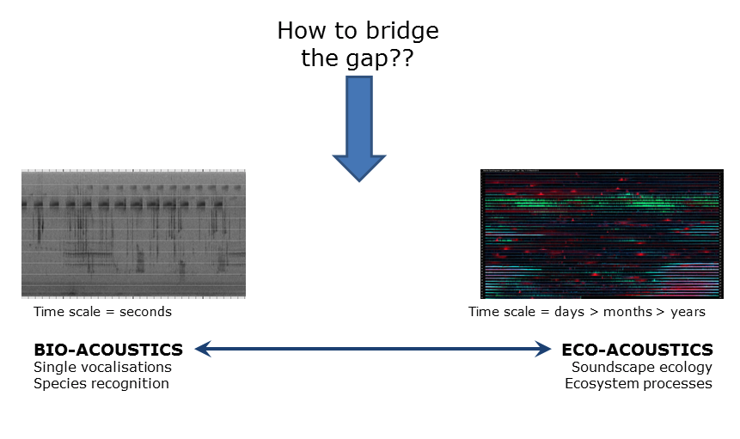
How to bridge the gap?

Slide 23
Combination Approaches
Estimating avian species richness from very long acoustic recordings.
Used acoustic indices to summarise the acoustic energy information in the recording
Randomly sampled 1 minute segments of 24 hour recordings - achieved a 53% increase in species recognised over traditional field surveys
Combinations of acoustic indices to direct the sampling - achieved an 87% increase in species recognized over traditional field surveys
Towsey et al. 2014. Ecological Infomatics 21: 110-119.

Slide 24
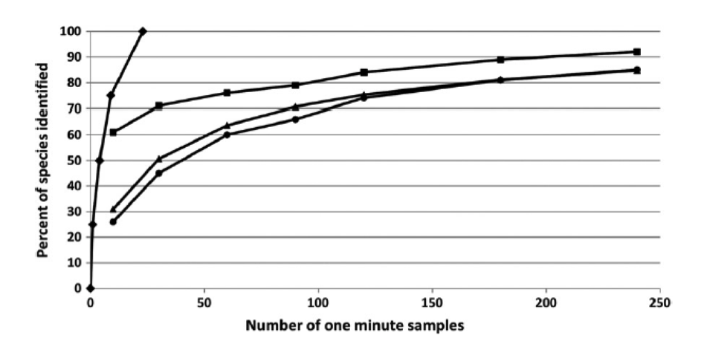
Sampling?
Greedy sampling with prior knowledge of all species present
Sampling with prior knowledge of # of species present
Random sampling
Sampling in descending order of signal amplitude
Different sampling protocols listening to 1 minute samples of a 5-day real sound sample - Towsey et al. 2014. Ecological Infomatics 21: 110-119.

Slide 25
Many Indices
Average signal amplitude
Background noise
Signal-to-noise ratio (SNR)
ACI
Acoustic activity
Count of acoustic events
Avg duration of acoustic events
Entropy of signal envelope (temporal entropy = H[t])
Mid-band activity
Entropy of average spectrum
(= H[s])
Entropy of spectral maximum
(= H[m])
Entropy of spectral variance
(= H[v])
Spectral diversity
Spectral persisitence
All defined in Towsey et al. 2014. Ecological Infomatics 21: 110-119.

Slide 26
Many Indices
Average signal amplitude
Background noise
Signal-to-noise ratio (SNR)
ACI
Acoustic activity
Count of acoustic events
Avg duration of acoustic events
Entropy of signal envelope (temporal entropy = H[t])
Mid-band activity
Entropy of average spectrum
(= H[s])
Entropy of spectral maximum
(= H[m])
Entropy of spectral variance
(= H[v])
Spectral diversity
Spectral persisitence
All defined in Towsey et al. 2014. Ecological Infomatics 21: 110-119.

Slide 27
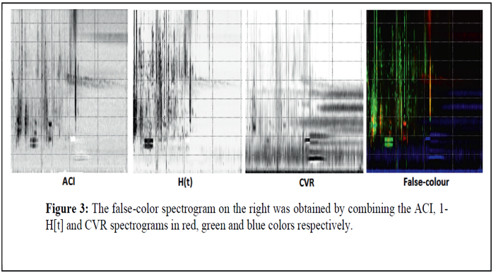
Visualisation of Large-scale Recordings – Using Indices to Reduce “Noise”

Slide 28
A visual approach to automatic classification from recordings in the wild
A multi-instance, multi-label framework on bird vocalizations to detect simultaneously vocalizing birds of different species.
Integrates novel, image-based heterogeneous features designed to capture different aspects of the spectrum.
monitor 78 bird species, 8 insects and 1 amphibian (total = 87 species under challenging environmental conditions)
The classification accuracy assessed by independent observers = 91.3% (note not compared to traditional surveys)
Potamitis, I. 2014. PLoS1 9(5):e96936

Slide 29
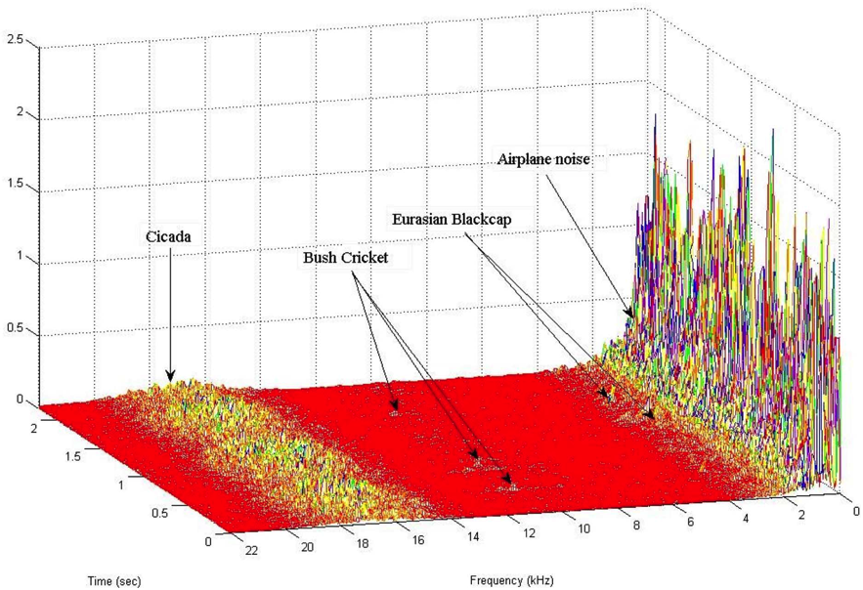
Illustration of Sound Interference

Slide 30
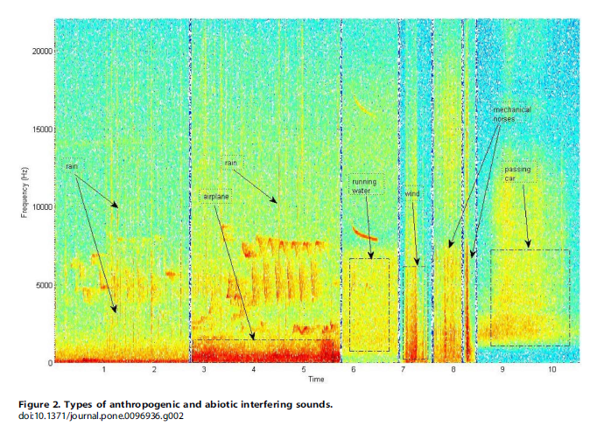

Slide 31
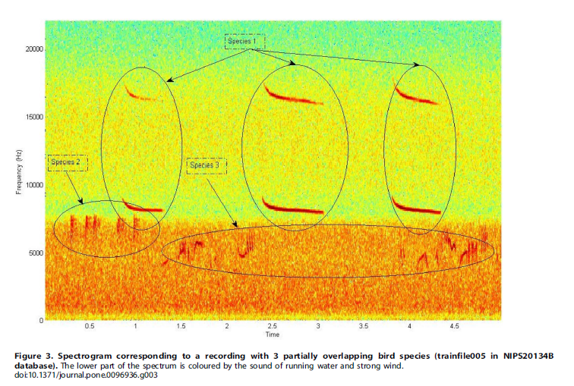

Slide 32
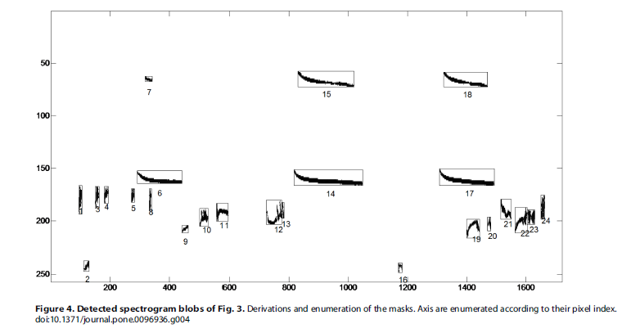

Slide 33
Conclusions
ARUs could be extremely valuable to collect a massive amount of data on species presence/absence, richness
Massive amount of data is a double edged sword
ARUs are especially good for rare or (acoustically) hard-to-detect species
There is a great deal of research to be done in how best to analyse this data

Slide 34
One more thing
Caller-listeners, rather than just listeners may increase the probability that a rare thing will call
Such an invention increases the probability of calling by rare species
Increases detectability of rare species, because then we know WHEN to look for their calls in long recordings

Slide 35
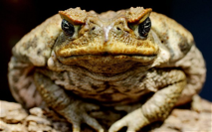
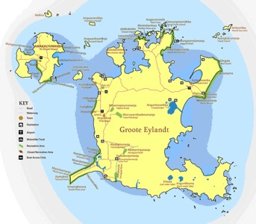
Current work: Detecting Invasive Species
Detecting the arrival of invasive cane toads on Groote
Listening & Calling for toads
Working with the Anindilyakwa
Land Council
Hoping not to get an answer!

Slide 37
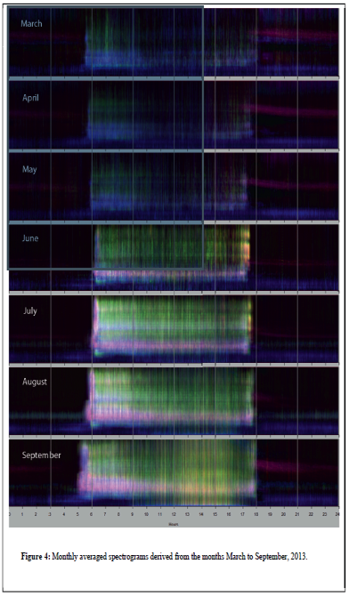
Monthly Average Spectrogram
Averaging values of acoustic indices over consecutive days
More ‘washed out’ appearance due to averaging
But seasonal changes in acoustic landscape are clearly visible
Morning chorus strongest during late winter and early spring
Night-time Orthopteran sounds are minimal during winter months

